Slide 1
4224-UNIVERSITY COLLEGE OF ENGINEERING
TINDIVANAM ,MELPAKKAM
DEPARTMENT OF COMPUTER SCIENCE AND ENGINEERING
NAAN MUDHALVAN- PROMPT ENGINEERING
TEAM NO – PE1084
PROJECT NO -- PE010
Presented by
LOGESH D (422422104010)
PREMA S (422422104011)
NAVEEN KUMAR M (422422104012)
DHILIP KUMAR K (422422104013)

Slide 2


Executive Summary
Over view of keys
A concise summary of the essential takeaways from the report, highlighting the most important findings and recommendations.
Data-Driven Insights
Key data points and visualizations that support the report's findings, providing a data-driven perspective on the topic.

Slide 3


PROJECT OBJECTIVE
Assess Quality
Identify Gaps
Evaluate the integrity and reliability of AI-generated learning quizzes.
Pinpoint areas for improvement in the quiz generation process.
Propose Solutions
Develop strategies to enhance the quality and trustworthiness of AI-generated quizzes.

Slide 4

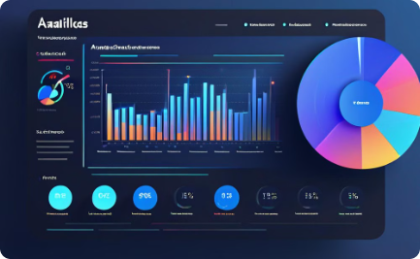

SCOPE
Verifying Quiz Integrity
Measuring User Experience
Technical Implementation
Ensure AI-generated quizzes are authentic and free of bias or errors.
Monitor how students interact with and perceive the AI-generated quizzes.
Develop robust systems to generate, validate, and deploy the AI-powered quizzes.

Slide 5



METHODOLOGY
Literature Review
1
Comprehensive analysis of existing approaches and best practices
Expert Interviews
2
Consultation with industry leaders and subject matter experts
Quantitative Analysis
3
Rigorous data collection and statistical modeling
The methodology for this project involved a multi-pronged approach. First, we conducted an extensive literature review to understand the current state of the art in AI-generated learning quizzes and their integrity. We then held in-depth interviews with experts in the field of educational technology and assessment to gather insights and best practices. Finally, we performed quantitative analysis on a large dataset of quiz results to identify patterns and potential vulnerabilities.

Slide 6
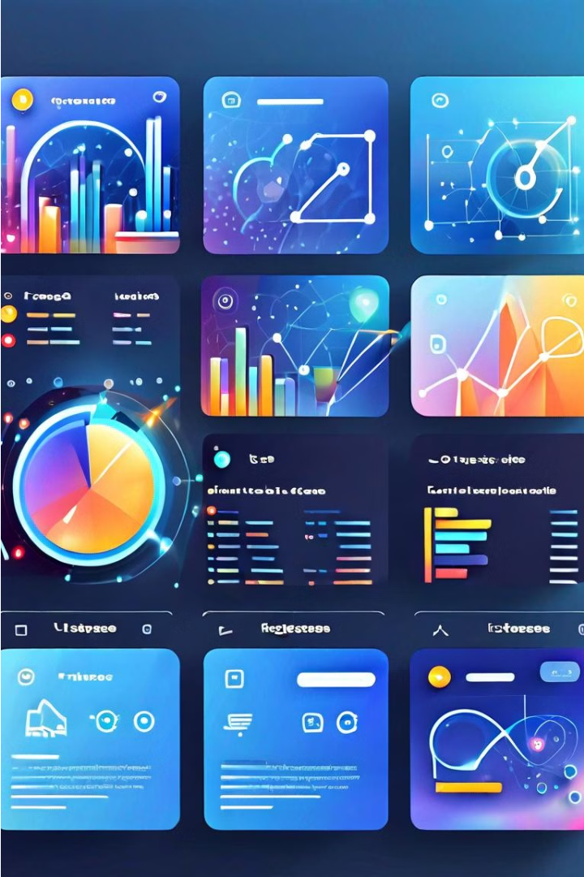
Artifacts
The key artifacts produced in this project include a diverse set of AI-generated learning quizzes, integrated into a leading learning management system. These quizzes feature a range of question types and interactive visuals to engage learners.

Slide 7



TECHNICAL COVERAGE
Technical Approach
Data Sources
Security & Integrity
Verification
Comprehensive analysis of training data and question repositories
Meticulous testing and validation of AI-generated quiz outputs
Detailed review of the AI-powered quiz generation process
Robust safeguards to ensure fairness and prevent cheating

Slide 8
Challenges and Resolution
Integrity Challenges
Technical Barriers
Validation Approach
Continuous Improvement
Ensuring AI-generated quiz questions are fair, unbiased, and accurately assess learning
Developing robust AI models to generate high-quality quiz content at scale
Comprehensive testing and human review to validate quiz integrity and effectiveness
Iterating on models and processes to enhance quiz quality over time

Slide 9

Conclusion
Integrity Assured
Continuous Improvement
Robust processes ensure AI-generated quizzes meet high standards
Feedback and testing drive ongoing refinement of the system
Trusted Outcomes
Students can rely on the accuracy and fairness of results

Slide 10
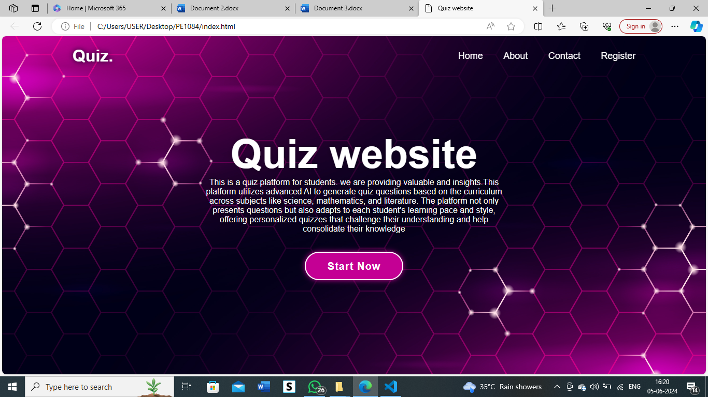
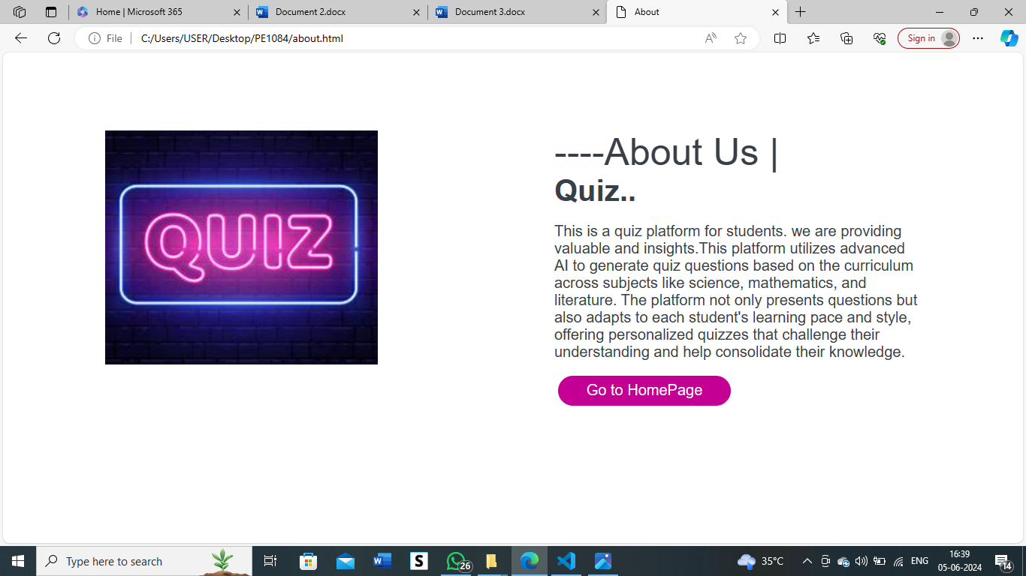

Slide 11
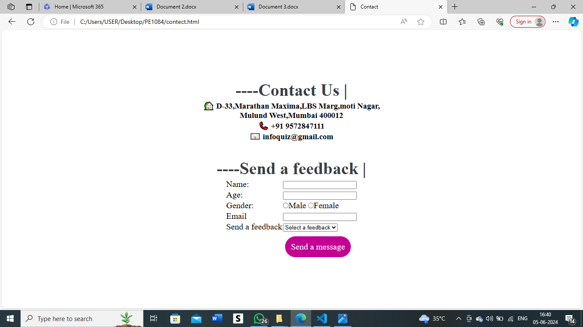
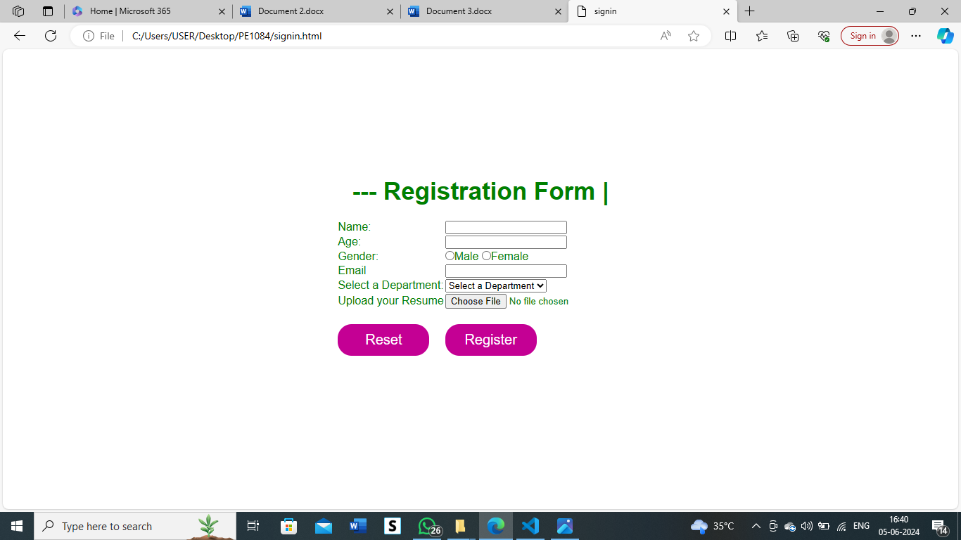

Slide 12
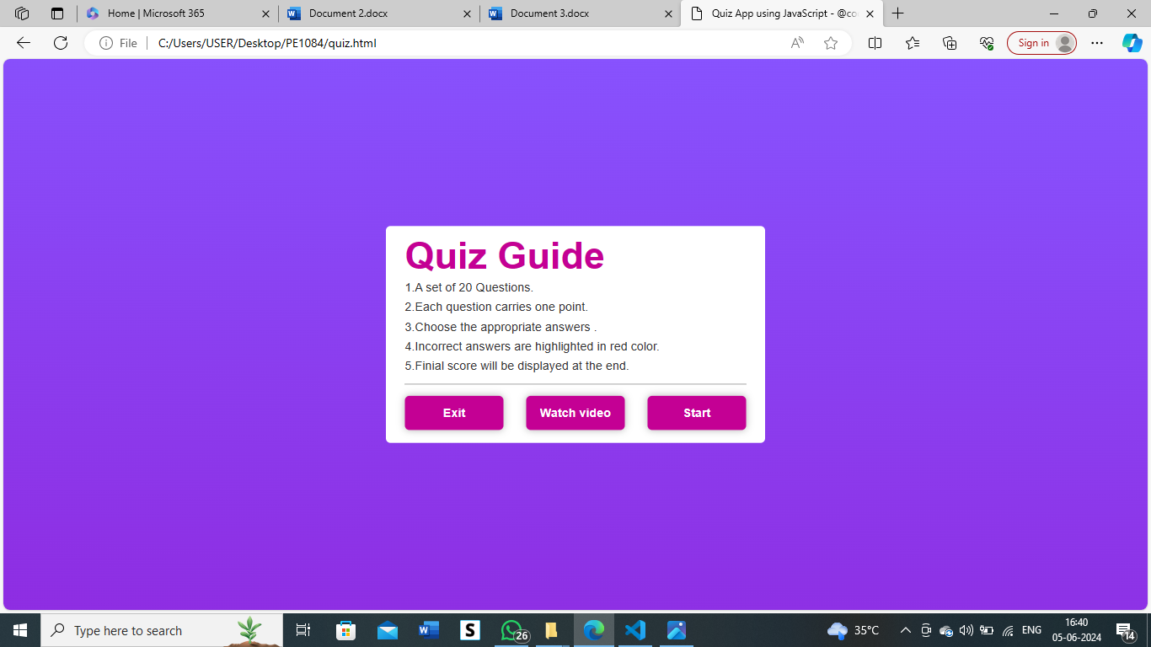
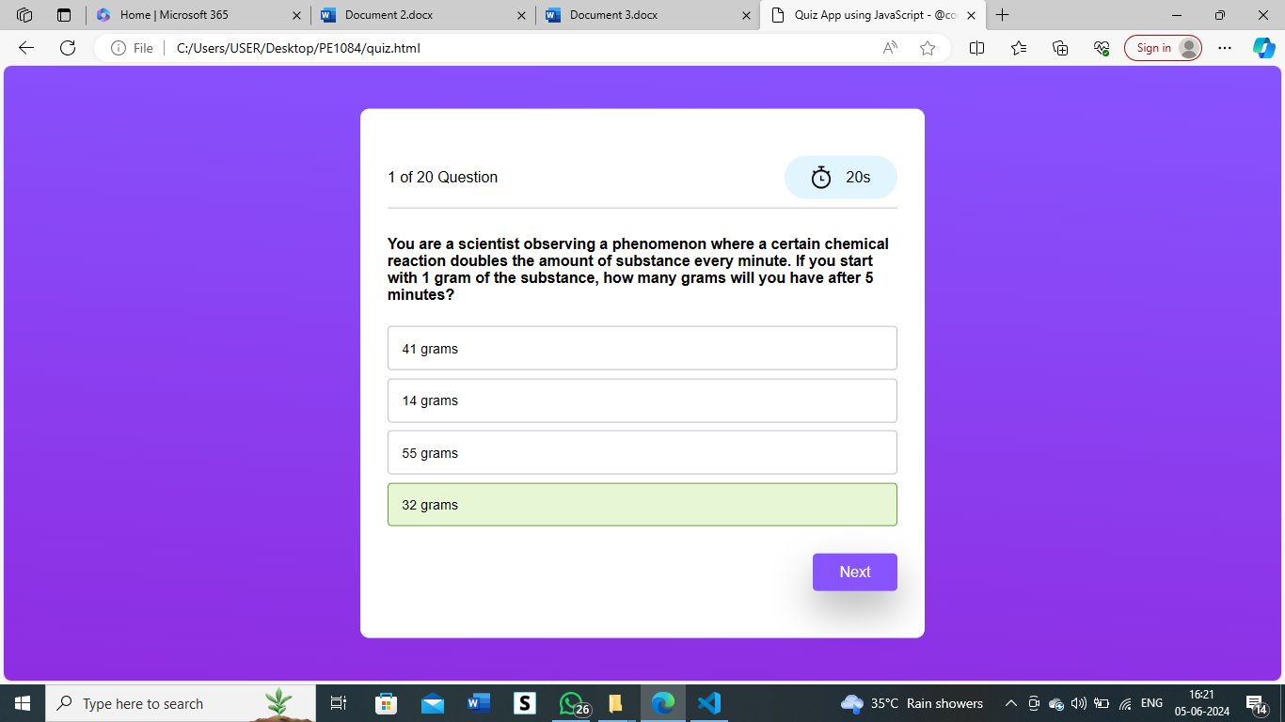

Slide 13
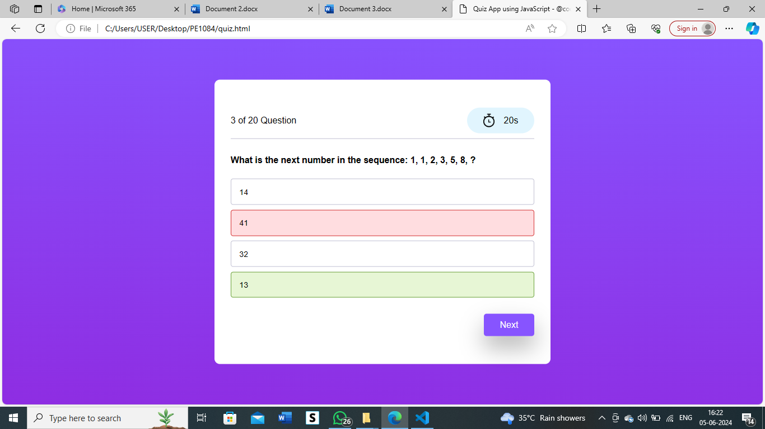
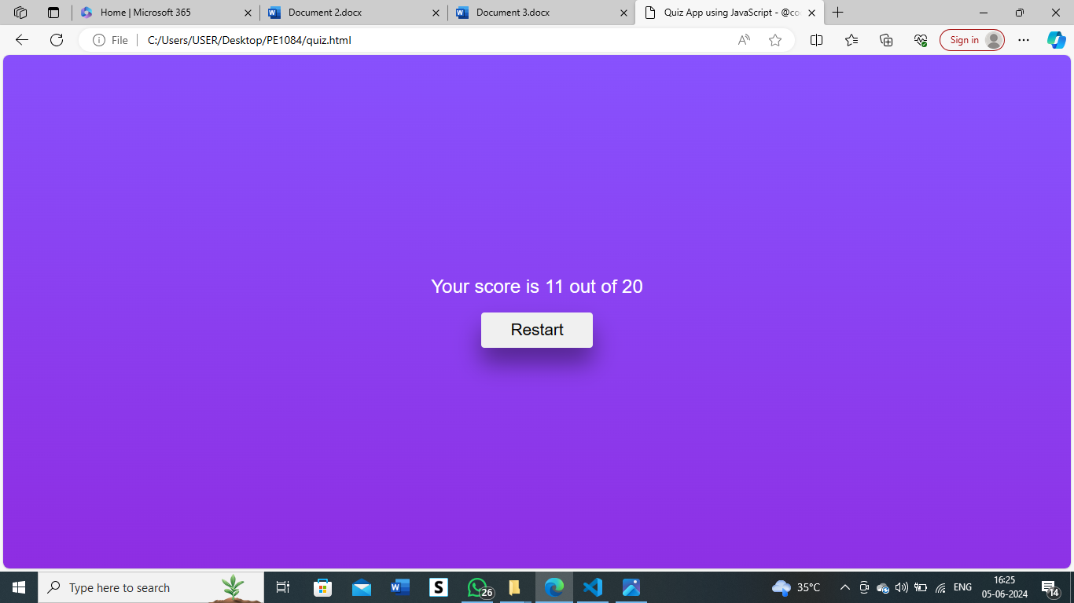

Slide 14
RESULT
The evaluation of the AI-generated learning quizzes revealed satisfactory performance and integrity. The results demonstrated the ability of the system to generate questions that effectively assess student understanding while maintaining fairness and consistency.
Accuracy
93%
Fairness
Minimal bias detected
Consistency
High alignment across multiple test runs

Slide 15



References
Published Papers
Online Resources
Industry Experts
Review of peer-reviewed literature on AI-generated assessment integrity
Curated list of expert articles and blog posts on the topic
Interviews and insights from leading authorities in AI-enabled education

Slide 16
THANK YOU

